Slide 1



Hardware and Software Fundamentals of Intelligent Computing Systems

Slide 2
Lecture 16: Complex Operator Debugging and Profiling

Slide 3
Outline
Overview
Nsight System
Nsight Compute
Case Study

Slide 4
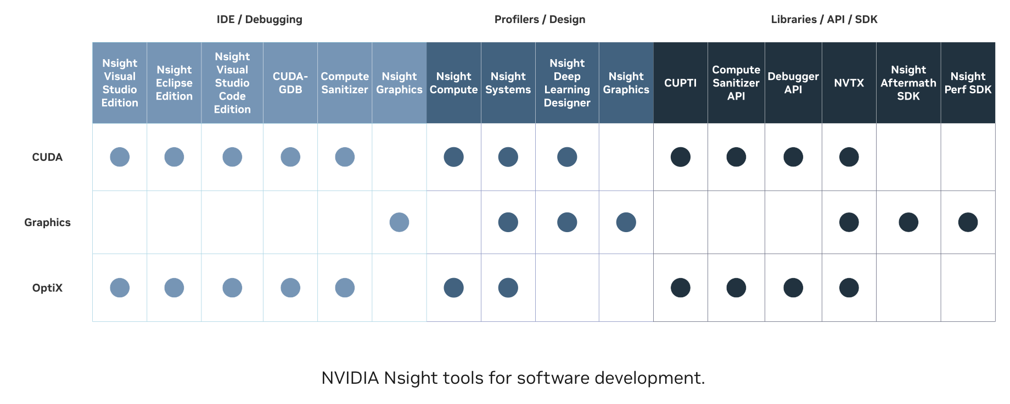
NVIDIA Nsight Developer Tools
NVIDIA Nsight™ tools are a powerful set of libraries, SDKs, and developer tools spanning across desktop and mobile targets that enable developers to build, debug, profile, and develop software that utilizes the latest accelerated computing hardware.
https://developer.nvidia.com/tools-overview

Slide 5
Nsight Product Family (for CUDA Profiling)
Tool Name | Analysis Level | Primary Features | Typical Use Cases
Nsight Systems | System-level | Cross CPU/GPU timeline analysis, API tracing, multi-process tracking | Low GPU utilization, multi-GPU load imbalance, CPU-GPU coordination issues
Nsight Compute | Kernel-level | CUDA kernel microarchitecture analysis, instruction-level performance metrics, optimization recommendations | Kernel performance bottleneck analysis, memory access optimization, register usage tuning

Slide 6
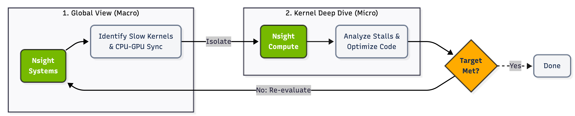
Optimization Workflow for CUDA Applications
Nsight Systems: System-wide application algorithm tuning
Nsight Compute: Debug/optimize specific CUDA kernel

Slide 7

NVIDIA Nsight Systems
NVIDIA Nsight™ Systems is a system-wide performance analysis tool designed to:
Visualize an application’s algorithms
Identify the largest opportunities to optimize
Tune to scale efficiently across any quantity or size of CPUs and GPUs
https://developer.nvidia.com/nsight-systems

Slide 8
NVIDIA Nsight Systems - Features
View system-wide application behavior across CPUs and GPUs
CPU cores utilization, process & thread activities, thread backtraces, CPU performance metrics
GPU workload trace, GPU context switch trace.
SOC traces (hypervisor, memory bandwidth, accelerators)
OS Event Trace (ftrace, ETW)
Investigate CPU-GPU interactions and bubbles
Compute & AI APIs: CUDA API, CUDA libraries trace, Bidirectional correlation of API and GPU workload.
Graphics & Rendering: OpenGL API, Vulkan API, etc.
Workflow & Resource Analysis: User annotations API trace, Identify GPU idle and sparse usage
https://developer.nvidia.com/nsight-systems/get-started

Slide 9
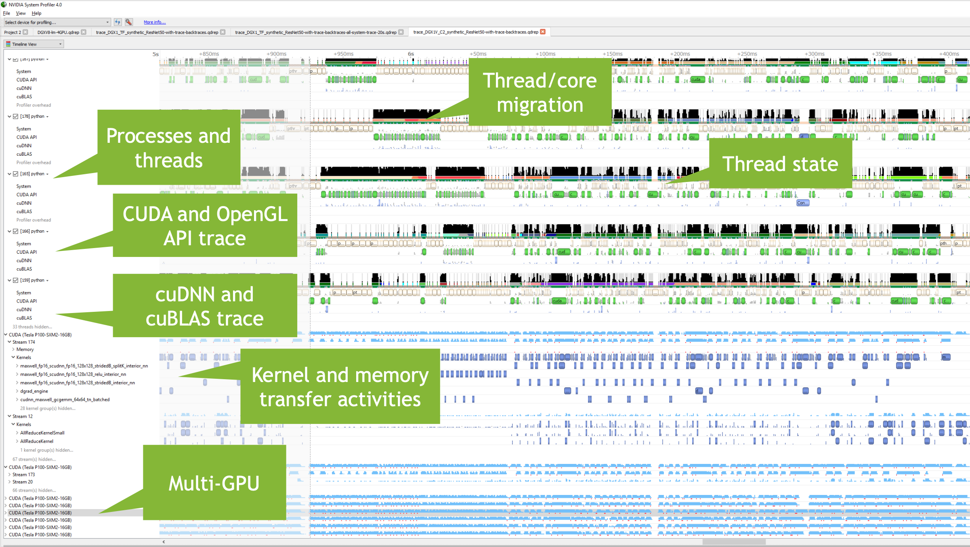
NVIDIA Nsight Systems
Notes:
https://developer.download.nvidia.cn/video/gputechconf/gtc/2019/presentation/s9345-cuda-kernel-profiling-using-nvidia-nsight-compute.pdf

Slide 10
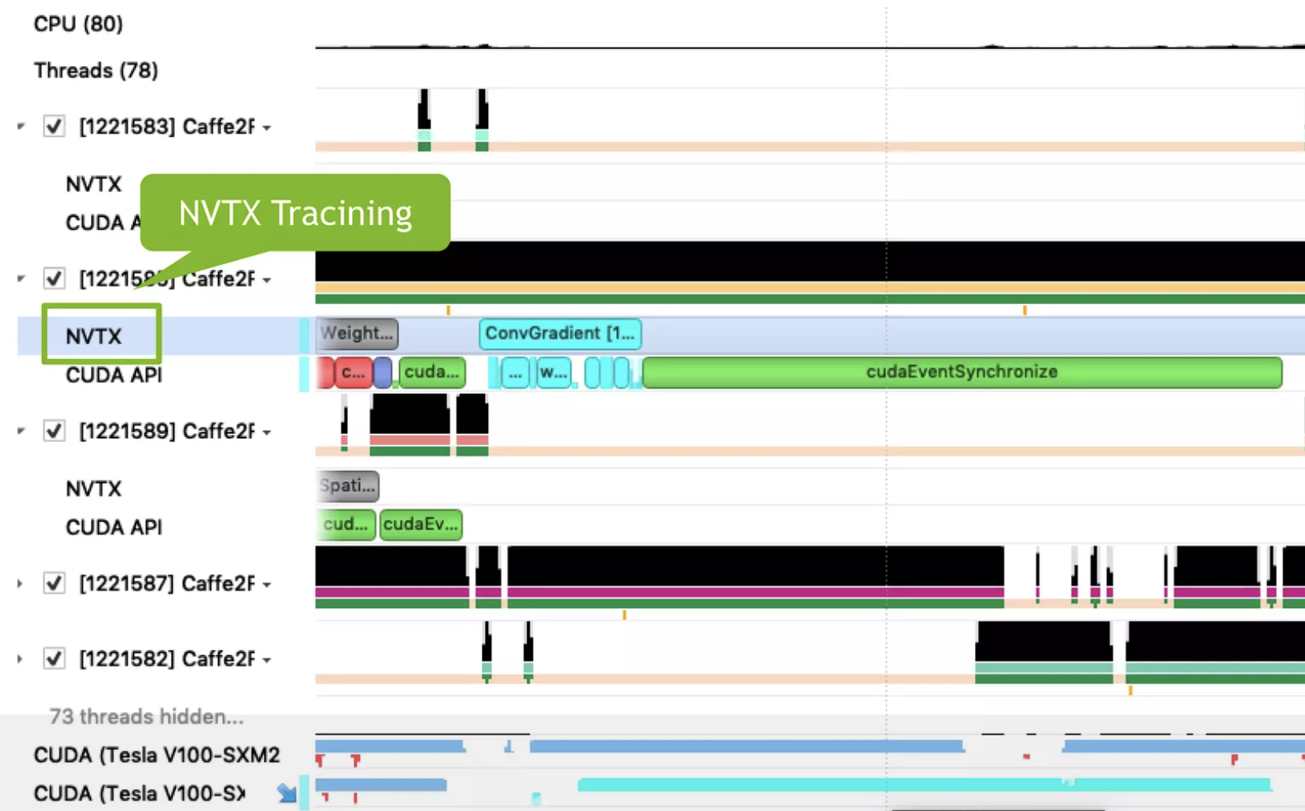
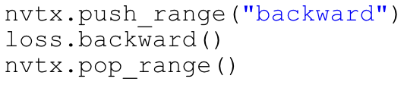
NVIDIA Nsight Systems
NVTX: A profiling API that annotates performance timelines with custom event markers
Notes:
https://www.slideshare.net/slideshow/profiling-deep-learning-network-using-nvidia-nsight-systems/170158704

Slide 11
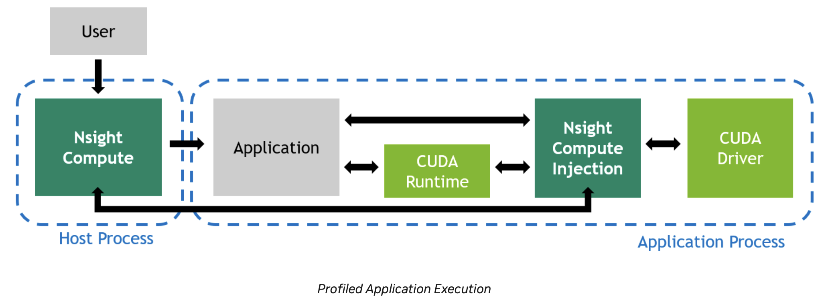
NVIDIA Nsight Compute
NVIDIA Nsight™ Compute is an interactive profiler for CUDA® and NVIDIA OptiX™ that provides detailed performance metrics and API debugging via a user interface and command-line tool.
https://developer.nvidia.com/nsight-compute
https://docs.nvidia.com/nsight-compute/ProfilingGuide/index.html

Slide 12
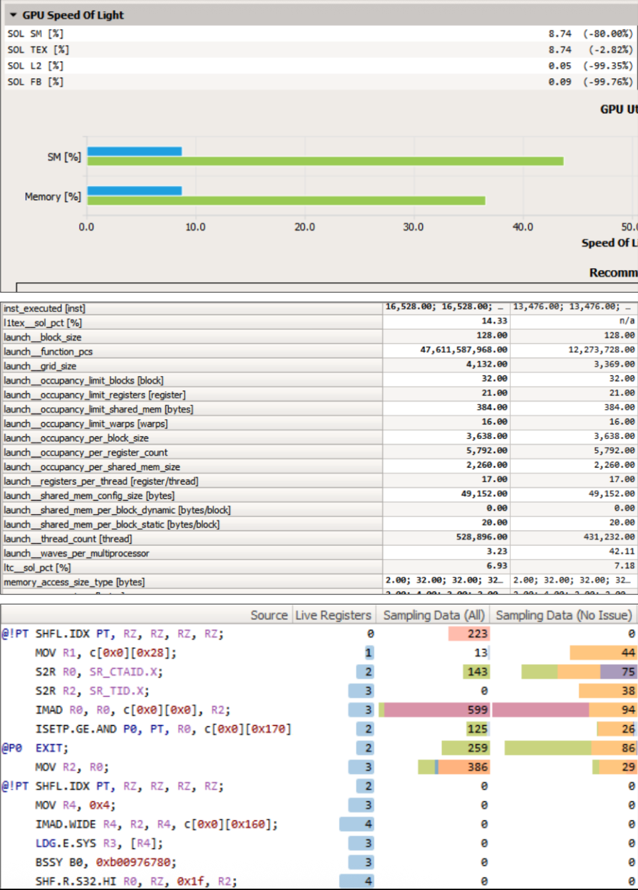
NVIDIA Nsight Compute - Features
Interactive CUDA API debugging and kernel profiling
Graphical profile report
Comparison of multiple kernel reports
Fully Customizable (Reports and Analysis Rules)
Command Line, Standalone, IDE Integration
https://developer.download.nvidia.cn/video/gputechconf/gtc/2019/presentation/s9345-cuda-kernel-profiling-using-nvidia-nsight-compute.pdf
Notes:
单击此处添加文本

Slide 13
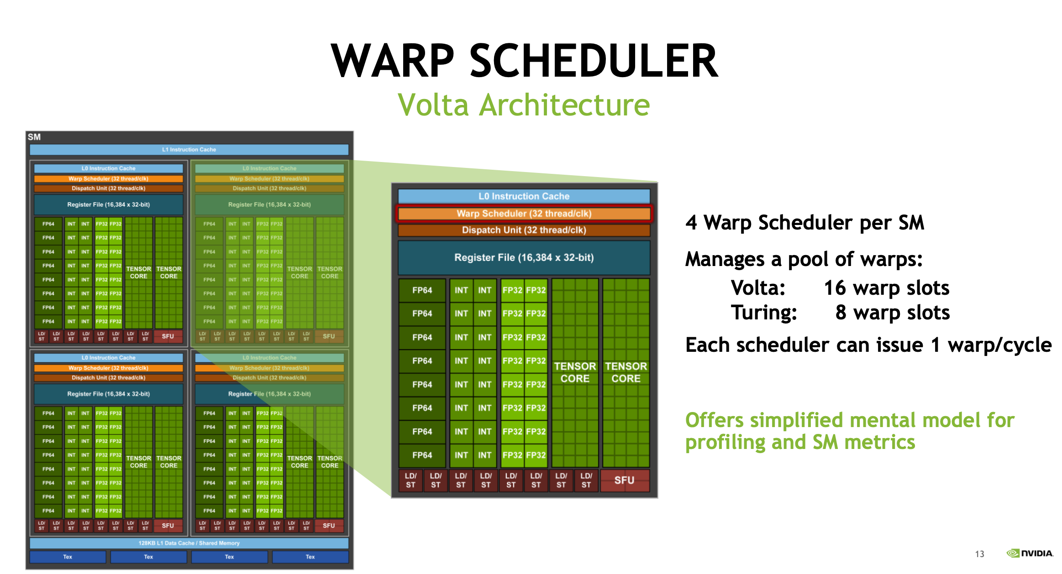
Notes:
https://developer.download.nvidia.cn/video/gputechconf/gtc/2019/presentation/s9345-cuda-kernel-profiling-using-nvidia-nsight-compute.pdf

Slide 14
Key Metrics for Warp-Level Analysis
Scheduler Statistics
Nsight Compute tracks active and eligible warps per cycle to evaluate instruction issue efficiency and latency-hiding performance.
Warp State Statistics
Nsight Compute profiles warp stall cycles to identify the specific hardware bottlenecks delaying instruction execution.
Occupancy
Nsight Compute compares actual versus theoretical active warps to assess overall GPU resource utilization and workload balance.
https://developer.download.nvidia.cn/video/gputechconf/gtc/2019/presentation/s9345-cuda-kernel-profiling-using-nvidia-nsight-compute.pdf
Notes:
单击此处添加文本

Slide 15
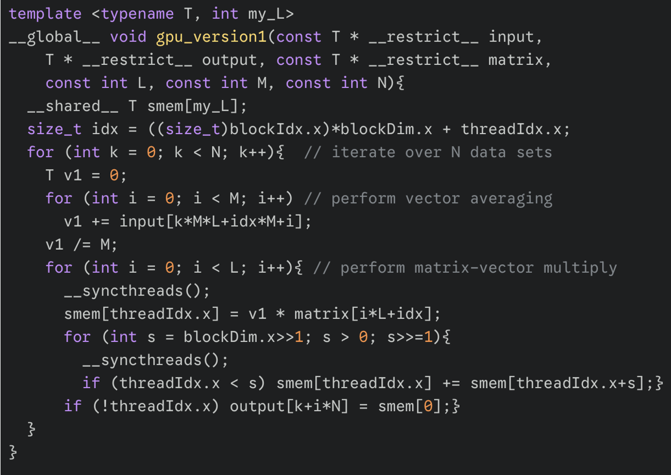
Case Study: Vector Averaging & Matrix Multiply
Some highlights:
OpenMP
Initial port
Kernel Design
Shared memory
https://developer.nvidia.com/blog/analysis-driven-optimization-preparing-for-analysis-with-nvidia-nsight-compute-part-1/
Notes:
单击此处添加文本

Slide 16
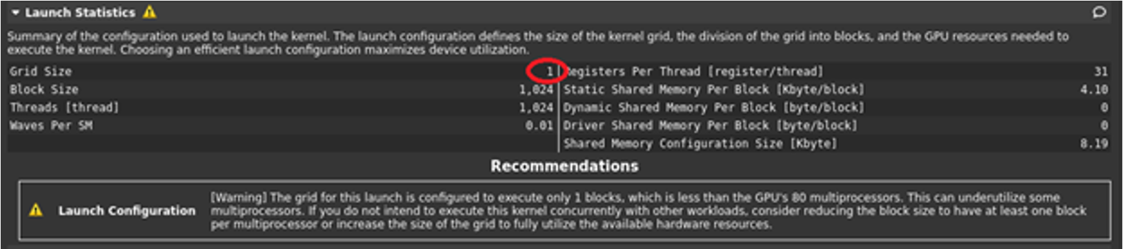
Iteration 1: Maximizing Grid Size
Issue: Indicates kernel grid too small to utilize device resources efficiently.
Action: Distribute work across N blocks instead of a single block (<<<N, L>>>).
Result: Drops execution time from 2.92s to 0.0789s
Notes:
单击此处添加文本

Slide 17
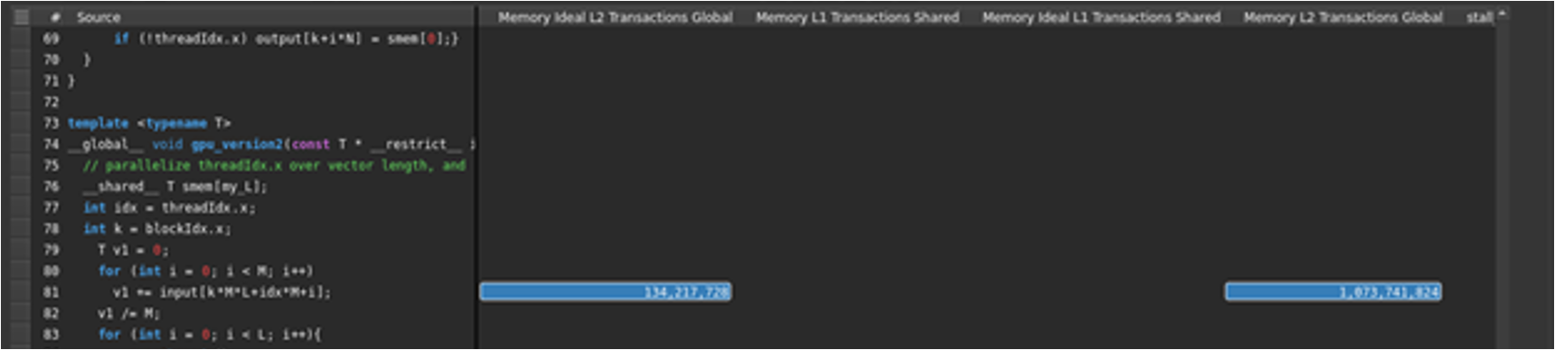
Iteration 2: Global Memory Coalescing
Issue: Reveals LSU queue full; shows 8:1 ratio of actual to ideal L2 transactions (uncoalesced access).
Action: Implement warp-stride and block-stride loops for contiguous memory reads.
Result: Improves execution time to 0.0216s.
Notes:
单击此处添加文本

Slide 18
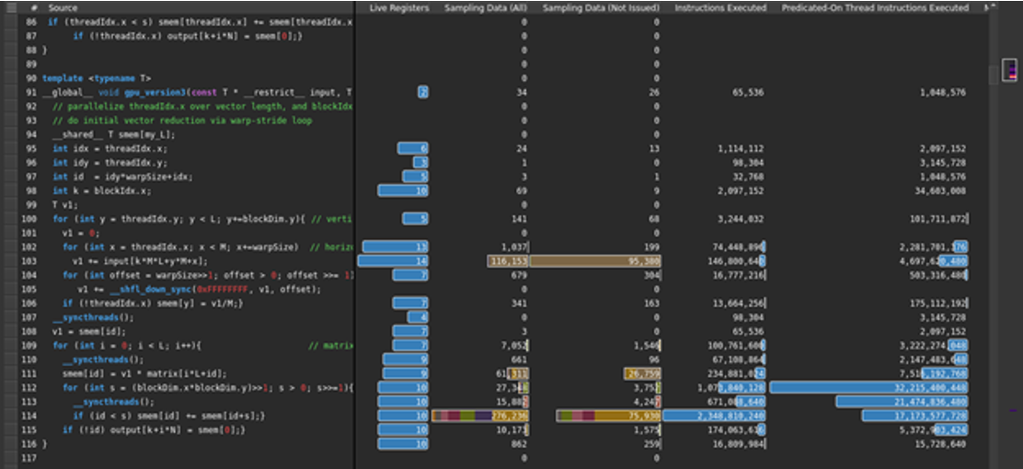
Iteration 3: Shared Memory Pressure
Issue: Shows high shared memory usage; pinpoints warp stalls caused by sweep reduction.
Action: Replace shared memory operations with two-stage warp-shuffle reduction (__shfl_down_sync).
Result: Decreases execution time further to 0.0126s.
Notes:
单击此处添加文本

Slide 19
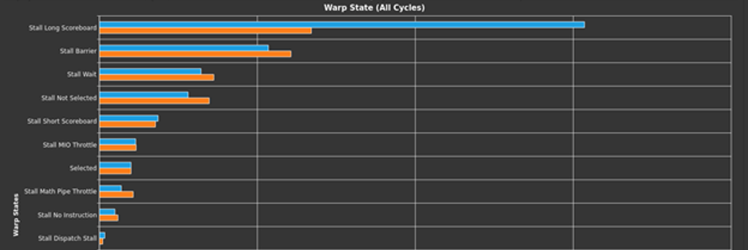
Iteration 4: Overcoming Memory Latency
Issue: Identifies Stall Long Scoreboard as primary bottleneck (46.1%), indicating L1TEX data dependency.
Action: Split into two kernels: custom vector averaging and highly optimized cuBLAS SGEMM for matrix multiplication.
Result: Reaches 0.0055s execution time (nearly 100x speedup over CPU OpenMP)
Notes:
单击此处添加文本

Slide 20
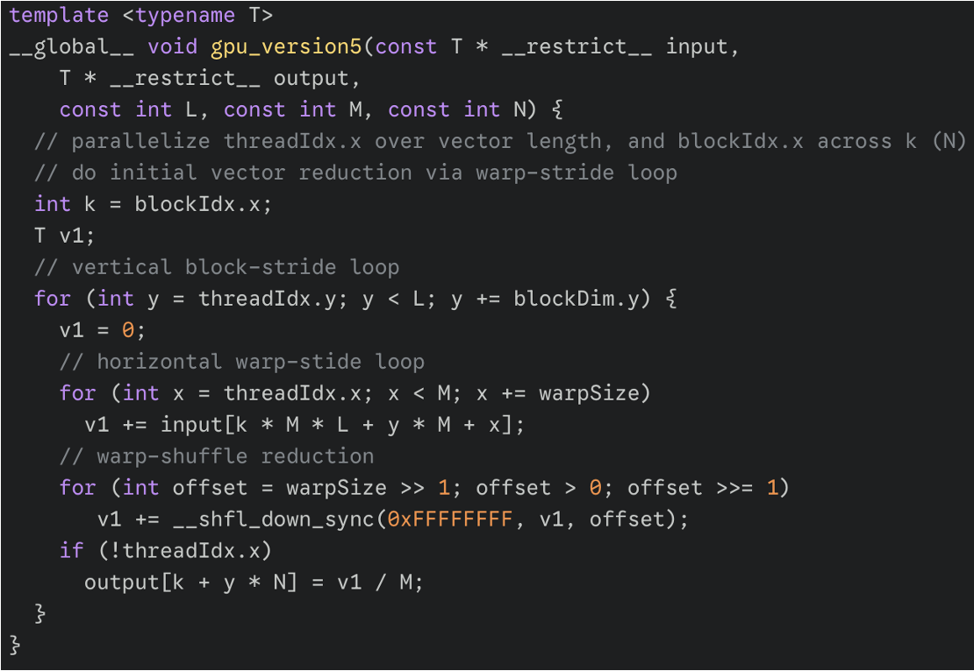
Estimation of Optimization Space
Bound by hardware bandwidth
~823 GB/s achieved throughput
Near-optimal global loading
Require algorithmic redesign
Notes:
单击此处添加文本

Slide 21
References
Get Started With Nsight Systems
Getting Started with Nsight Compute
Nsight Systems Documentation
Nsight Compute profiling guide
Notes:
单击此处添加文本

Slide 22

The Solution: FlagOS, a Unified AI Software Stack

Slide 23








https://space.bilibili.com/3546791834290849
https://github.com/flagos-ai
https://www.zhihu.com/people/95-22-20-18/posts
https://flagos.io/Home

Slide 24

Thanks for your time！

